Slide 1
Getting started with Eclipse
Author: Loh Jianxiong Christopher
Contributions: Chua Jie Sheng, Li Mengran, Peh Shao Hong, Oo Theong Siang, Tong Chun Kit, Tania Chattopadhyay

Slide 2
Introduction to Eclipse
A powerful IDE (Integrated Development Environment)
Provides many features and tools to aid in software development
Download the latest version of Eclipse from: http://www.eclipse.org/downloads/

Slide 3
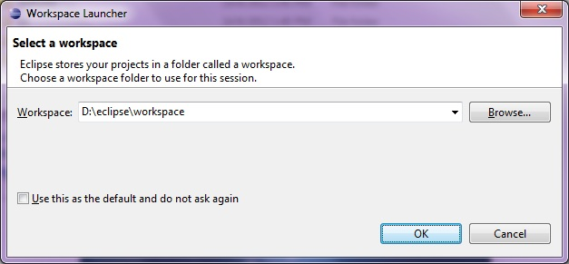
Starting Eclipse
When you first start Eclipse, you will be asked to set a workspace folder, which is the location where all your project related files will be stored

Slide 4
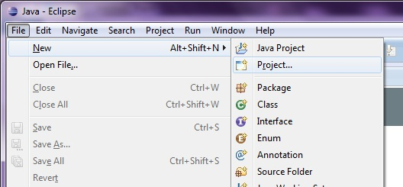
Creating HelloWorld Project
On the top menu bar, click:
File → New → Project.
[For Mac Users] If New menu is empty, right click on a blank area of the Package Explorer. (See Next Slide)

Slide 5
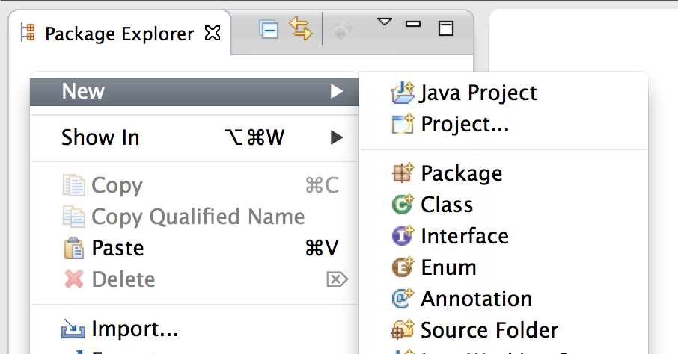
Creating HelloWorld Project (Mac Users)
Right-click on the blank area of Package Explorer, click:
New → Project.

Slide 6
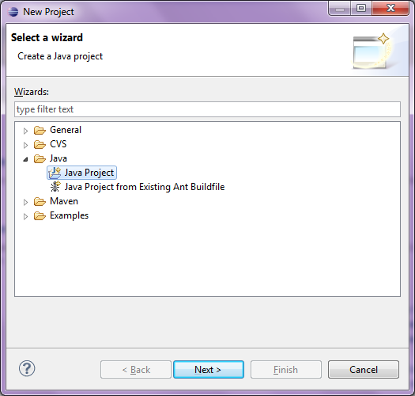
Hello World!
Select “Java Project” from the wizard, and click “Next>”

Slide 7
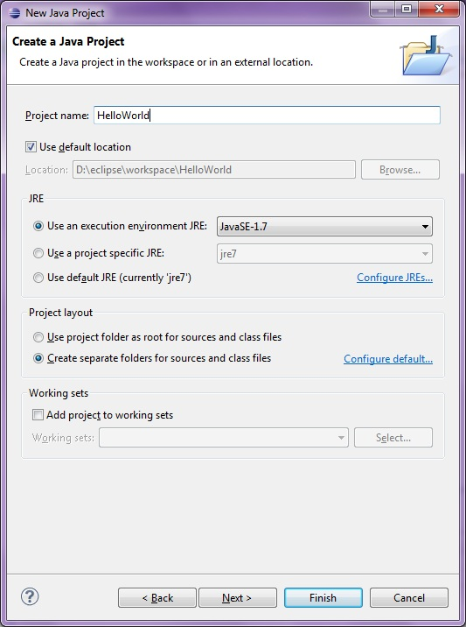
HelloWorld
Type in our project name “HelloWorld” and click “Finish”.

Slide 8
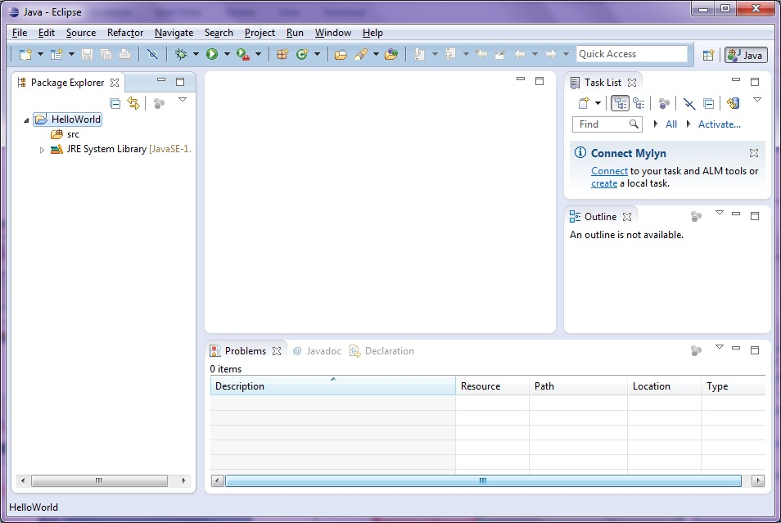
The Workbench
That should bring you to the ‘Workbench’. It has following main components.
The package explorer pane displays the various files (some source, some bytecode) included in your project in the form of a tree.
Click the triangular buttons to the left of the individual folders to expand or collapse them. (If a folder is empty, the expand/collapse button is not displayed)
This is the editor area. Since no file is opened, it’s blank.
Task list is the place where you can assign tasks within the project.
This is where various output from the IDE are displayed. We are currently at the Problems pane.
The Outline pane displays an outline of a structured file that is currently open in the editor area, and lists structural elements.

Slide 9
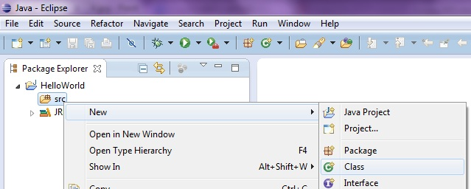
Adding a new class
Now, let us add a new class to our project.
Right click on the folder “src” and select New -> Class

Slide 10
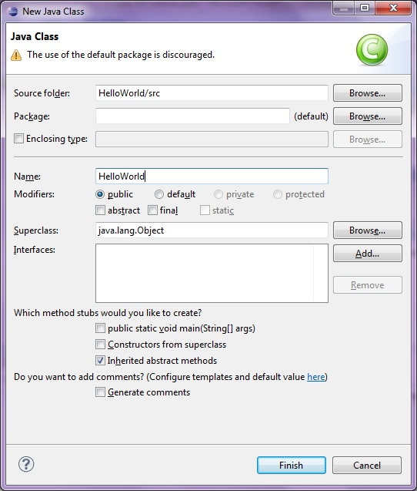
Name the new class
In the Name field, type in “HelloWorld” Then press “Finish”.

Slide 11
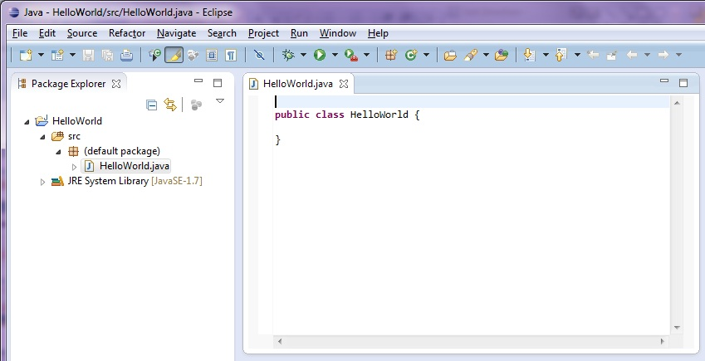
Start Editing
To star editing, double click “HelloWorld.java” in Package Explorer to open it up in the editor pane.

Slide 12
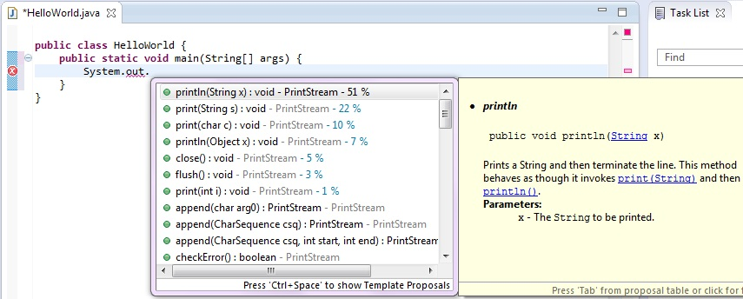
Eclipse Code-Assist
Now write the main function as shown and type in:
System.out.println(“Hello World!”);
When typing code, the code-assist window pops up to help the user. This is called the ‘code assist’ feature. Double-clicking a selection (or press Enter at it) will have Eclipse fill in the rest of the code automatically.

Slide 13
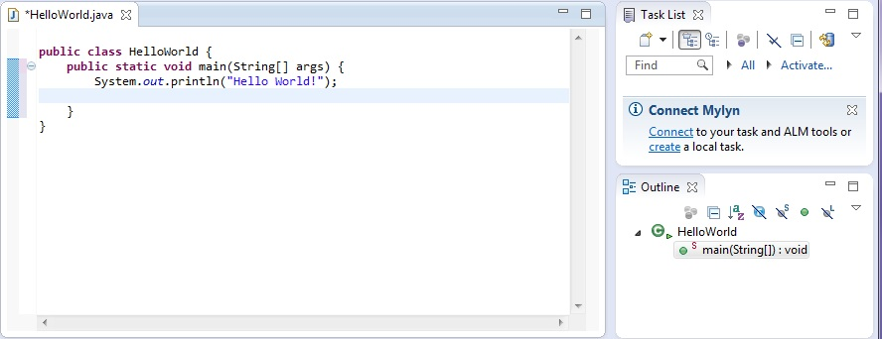
Outline Pane
Notice that the Outline pane gives a structural view of “HelloWorld.java”, that it contains the class “HelloWorld”, in which there is a function “main”.

Slide 14
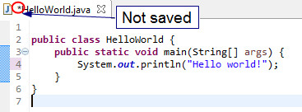
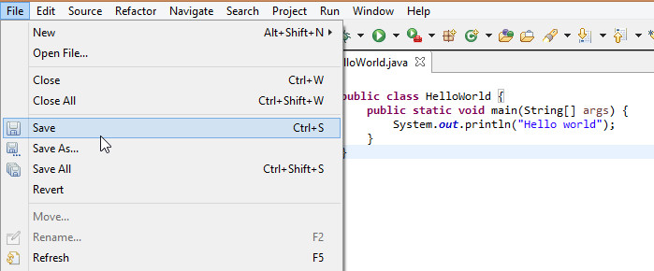
Save File
A ‘*’ preceding the class name indicates that the class is not saved.
To save HelloWorld.java, select File -> Save or press Ctrl+S.

Slide 15
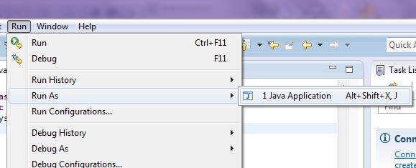
Running HelloWorld
To run our project, select
Run -> Run As -> Java Application
Note: In Eclipse, there is no need to compile before running (compilation is done automatically as you type).

Slide 16
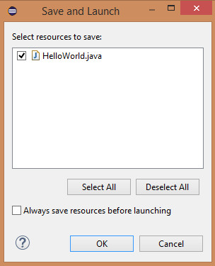
Note: If the file is not saved
If you run an unsaved file, the ‘Save and Launch’ window appears.
Select the classes you want to save and click ‘Ok’.

Slide 17
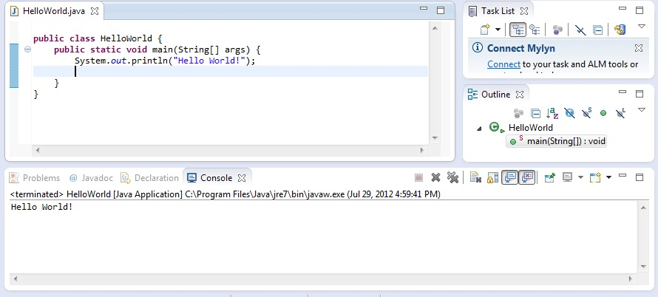
Output
Program output is displayed below the editor window under the ‘Console’ tab

Slide 18
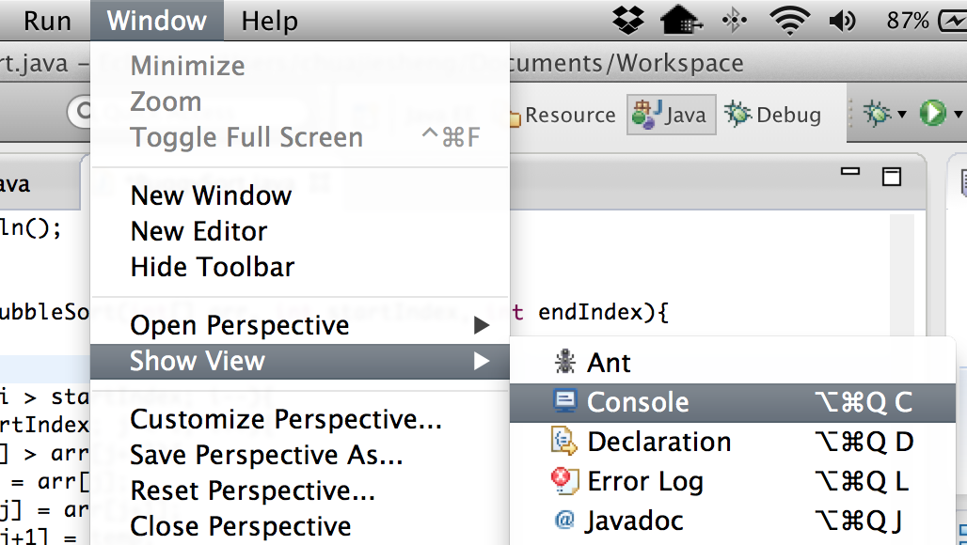
To View the Console
If the console is not visible, click: Window → Show View → Console.

Slide 19
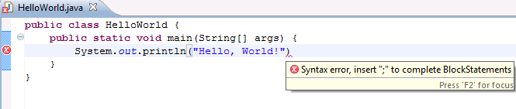
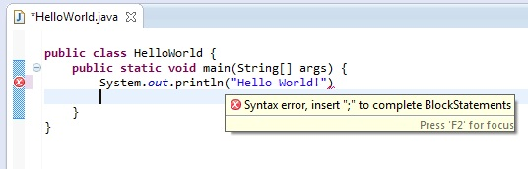
Error Detection and Correction
in the left margin means there is an error on that line. Red squiggly lines ( ) indicates where the error is. Moving the mouse over either will bring up a description of the error.
For example, had we forgotten to type the semicolon (;), we’d see this error below.

Slide 20
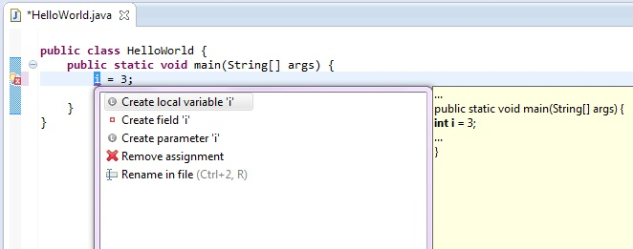
Error Detection and Correction
Sometimes Eclipse can attempt to correct errors. This is available when a light bulb icon ( ) is displayed on the left margin.
Click the light bulb icon to open the suggestion box.
We can pick a suggestion listed and Eclipse will do the correction accordingly.

Slide 21
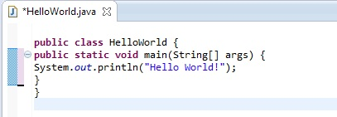
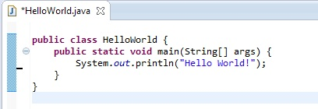
Auto Formatting
Select Source → Format or press Ctrl+Shift+F. Eclipse will auto format your code according to Java conventions.

Slide 22
End

